Slide 1
Synthetic Financial Datasets For Fraud Detection
Springboard Capstone Project
Melody Yang

Slide 2
Overview
Business Problem
Data Source
Exploratory Data Analysis
Modeling selection
Recommendation / Limitation

Slide 3
Business Problem
Problem: Financial companies are looking for ways to detect fraudulent transactions so that customers are not charged for items they did not purchase.
Goal: To implement machine learning models to detect fraudulent transactions and find out the factors that have a direct impact on the fraud.

Slide 4
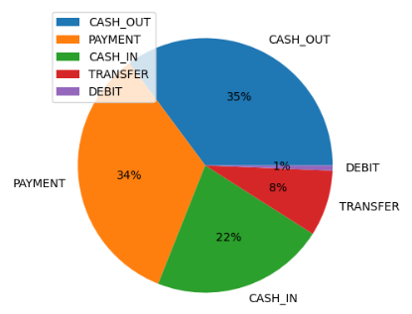
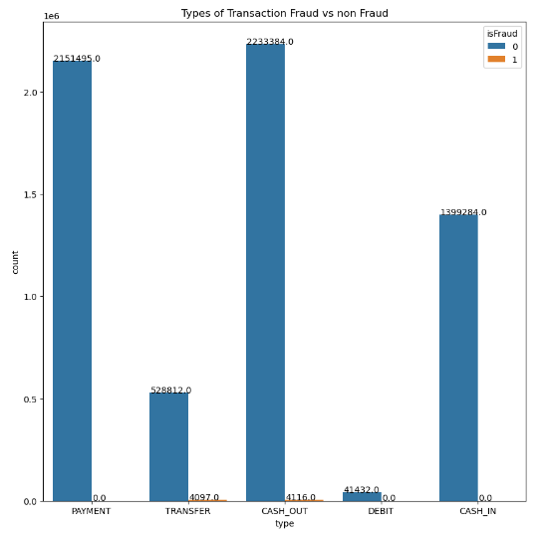
Data source / Exploratory Data Analysis (1/2)
Where is the data source?
What are the types of transaction?
What are fraudulent transactions?
This synthetic dataset is generated by the PaySim mobile money simulator from Kaggle.

Slide 5
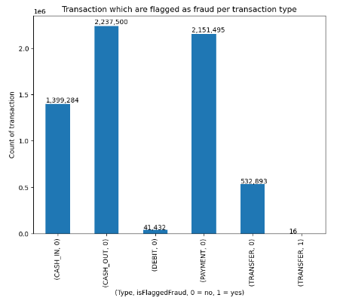
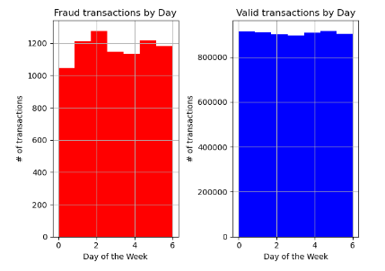
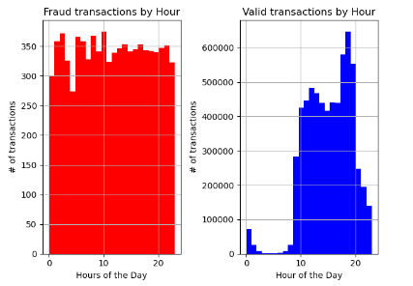
Data source / Exploratory Data Analysis (2/2)
Does timing have any impact on fraud?
What types of transactions are flagged as fraud in system?
How about fraud transactions vs valid transactions in hours?

Slide 6
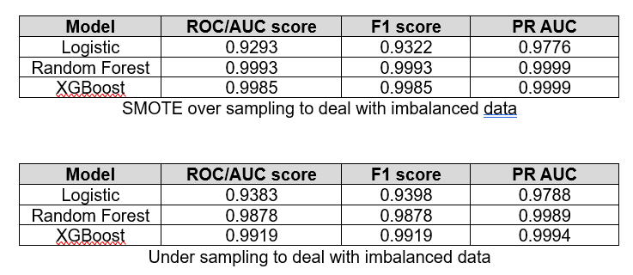
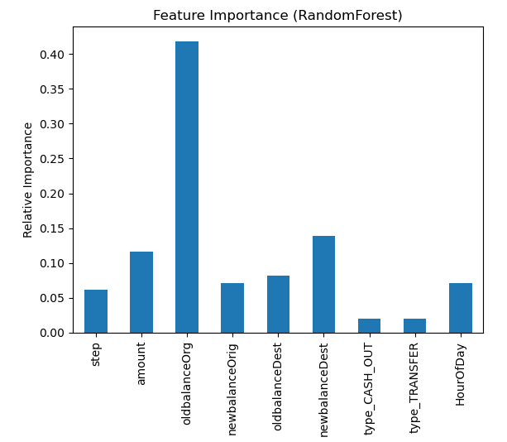
Model selection
Trained and tested 3 different models – Logistic, Random Forest classifier, and XGBoost classifier
Performed 2 sampling to deal with imbalanced data – SMOTE over sampling and under sampling
Evaluated models using AUC score
Best Model: Random Forest using SMOTE over sampling

Slide 7
Limitations/ Feature research
Limitations: This is dataset was generated by the PaySim mobile money simulator, therefore, it gave us the high AUC score at the beginning. It might not be feasible to see this in real business problem.
Future research: 1. Add more features such as location, online banking , or currency value 2. Try more machine learning models

